Slide 1

Quickwrite
What do you know about plotting points on a graph.
You have 2 minutes to write all you can remember
Notes:
Give them time to write what they know on the left hand side.
How you get the info off them is up to you, TPS, popcorn etc.

Slide 2
24
7
30
Date
Cartesian plane
EQ – How can we plot points on the Cartesian plane?
5
Notes:
Lesson objective (EQ)

Slide 3
Lesson objective
By the end of this lesson you will be able to;
Identify the four quadrants in the Cartesian plane
Plot and identify points on the Cartesian Plane
Notes:
Lesson

Slide 4
Success Criteria
You will know you are successful in achieving the objective by…
- Plot points on the Cartesian plane

Slide 5
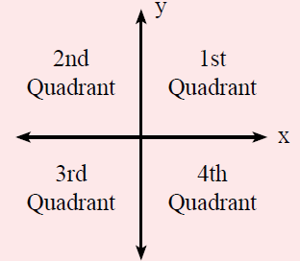

24
7
30
Date
Cartesian Plane
EQ- How can we plot points on the Cartesian plane?
What are the four quadrants?
$$Coordinates are \left(x,y\right)$$
5
Notes:
Input

Slide 6
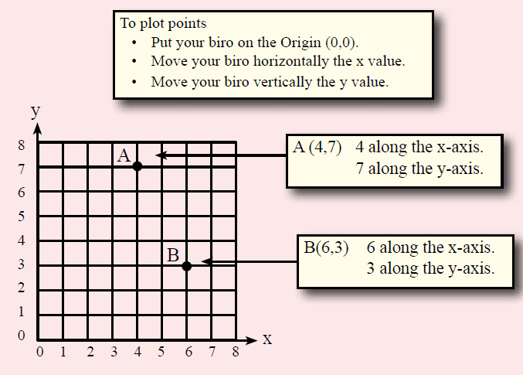
24
7
30
Date
Cartesian Plane
EQ- How can we plot points on the Cartesian plane?
How do you plot points on the cartesian plane?
5
Notes:
Input

Slide 7
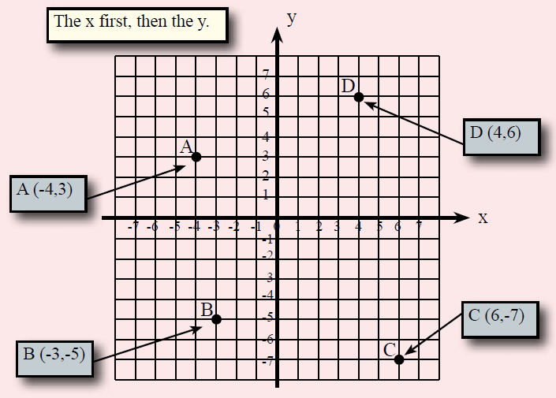
What are the Coordinates?
Notes:
Check for understanding

Slide 8

Complete the practice sheet
REMEMBER X-axis first (horizontal)
Notes:
They will be plotting points to draw a picture of a Kangaroo

Slide 9
Extension
Cartesian Plane Competition
Place a sticker on the correct coordinate and connect the dots.
Work as a team to finish fastest
The team that finishes first wins!
Notes:
In groups of 3 to 4 students will work together to complete the picture, by following the instructions

Slide 10
Instructions
Start (10,0) , (10,3) , (8,3) , (6,5) , (2,5) , (1,6) , (2,6) , (2,11) , (1,12), (1,16) , (2,17) , (2,26) , (3,25) , (4,26) , (5,25) , (6,26) , (7,25) , (8,26) , (9,25) , (10,26) , (11,25) , (12,26) , (13,25) , (14,26) , (15,25) , (16,26) , (17,25) , (18,26) , (18,15) , (17,4) , (16,3) , (16,0) Stop
Start (8,11) , (6,13) , (6,16) , (7,18) , (9,19) , (11,19) , (13,18) , (14,16) , (13,12) , (10,11) , (9,11) Stop
Start (6,9) , (5,8) , (4,8) , (3,9) , (3,10) , (4,11) , (5,11) , (6,12) , (7,12) Stop
Start (6,17) , (5,18) , (4,18) , (2,17) Stop
Start (3,11) , (2,11) Stop
Start (7,5) , (10,5) , (11,6) , (13,6) , (14,5) Stop
Start (13,7) , (13,6) Stop
Start (17,11) , (18,12) , (19,11) , (19,9) , (18,8) , (17,8) , (16,9) Stop
Big dot at (4,15)
Big dot at (11,15)
Notes:
There will be a hand out for each group with the instructions also

Slide 11
